Slide 1
TopCAT Configuration
Antony Wilson
ICAT Workshop
Scientific Computing Department, RAL
27th September 2012

Slide 2
Overview
Configuration
Configuration files
Configuration script
Facilities search panel
Summary

Slide 3
Configuration

Slide 4
TopCAT tar
TopCAT released as a tar that includes
A configuration script
Example configuration files
The configuration script is deploy.sh
Configuration files
deploy.conf
icats.d/icat.list
icats.d/localhost.icat
topcat.properties

Slide 5
Example deploy.conf
# Database connection information
DB_TYPE=oracle
#DB_TYPE=mysql
DB_ROOT_PASSWORD=secret
DB_HOSTNAME=localhost
# Topcat database schema user name and password
TOPCAT_DB_USER_NAME=topcat
TOPCAT_DB_PASSWORD=mytopcatpasswd
# Topcat war file location
WAR_LOCATION=TopCAT.war
# Must contain "glassfish/domains“
GLASSFISH_HOME=/usr/glassfish3
# Port for glassfish admin calls (normally 4848)
GLASSFISH_ADMIN_PORT=4848
Notes:
Create a deploy.conf from the deploy.conf.example and customise it as required

Slide 6
deploy.conf
The DB_ROOT_PASSWORD is ONLY required if you are using deploy.sh to create or delete the TopCAT schema/database and user
If your db URL is NOT in the form jdbc:dbType:thin:@//hostname:port/dbName add a value for databaseURL in deploy.conf

Slide 7
Configuration Script
Currently the script is bash
Being migrated to python
Prerequisites
Glassfish => v3
A database
Oracle
MySQL
Notes:
There looks to be an issue in the deploy.sh for setting up the connection pool if you are using MySQL

Slide 8
Bash Configuration Script Options
Script options
setupDB
deleteDB
create
delete
deploy
undeploy
setupICAT
deleteICAT

Slide 9
Bash Configuration Script Options
./deploy.sh setupDB
Create the TopCAT database and the topcat user
./deploy.sh deleteDB
Delete the TopCAT database and user
ONLY for use in a testing environment or if you want to do a clean installation
Notes:
On some sites for the production system there maybe a DBAdmin who will create the database/schema for you and give you the contact string

Slide 10
Bash Configuration Script Options
./deploy.sh create
Create the jdbc connection pool in Glassfish
./deploy.sh delete
Delete the jdbc connection pool in Glassfish

Slide 11
Bash Configuration Script Options
./deploy.sh deploy
Deploy TopCAT within Glassfish
./deploy.sh undeploy
Un-deploy TopCAT from Glassfish
Notes:
Deploying TopCAT will result in the tables being created if they do not already exist

Slide 12
Bash Configuration Script Options
./deploy.sh setupICAT
Add entries for ICATs to TopCAT
./deploy.sh deleteICAT
Delete entries for ICATs from TopCAT
These currently rely on two or more configuration files
Notes:
You must deploy TopCAT first (./deploy.sh deploy) in order to create the tables, as setupICAT writes to the tables.

Slide 13
Configuring TopCAT to Point to ICAT(s)
icats.d/icat.list contains a list of .icat files
Each .icat file contains details about an ICAT
To connect to additional ICATs create corresponding .icat files and add them to the list in icat.list
Notes:
In the new Python version of the configuration script the icat.list file will no longer be used.
The presence of an .icat file in the icats.d directory will be sufficient for it to be used by the configuration script
In order to communicate with a secure ICAT server the TopCAT server must trust ICAT
openssl s_client -showcerts -connect HOST.DOMAIN:PORT</dev/null | sed -ne '/-BEGIN CERTIFICATE-/,/-END CERTIFICATE-/p' > $GLASSFISH_HOME/domains/domain1/config/facility.cert
keytool -import -noprompt -alias XXXX -file $GLASSFISH_HOME/domains/domain1/config/facility.cert -keystore $GLASSFISH_HOME/domains/domain1/config/cacerts.jks --storepass changeit

Slide 14
Example localhost.icat
FACILITY_NAME=ICAT
ICAT_URL=http://localhost:8080/ICATService/ICAT?wsdl
ICAT_VERSION=v420
Notes:
This is currently only giving you the option to provide the main fields. In the new script you will be able to provide all the configuration options.

Slide 15
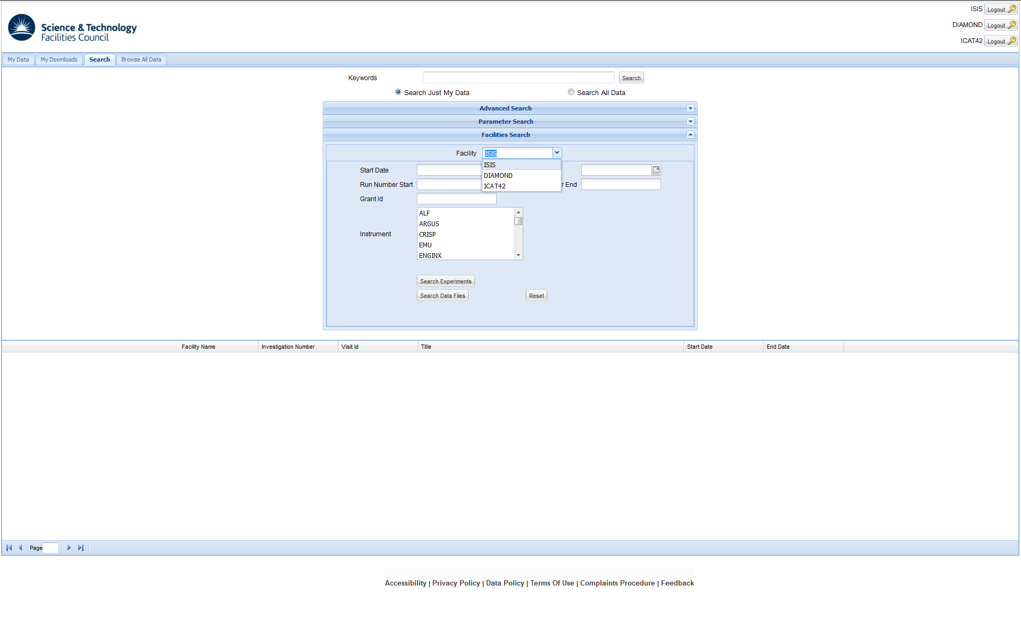
topcat.properties
Allows you to change the logo
Provides the values for the links at the bottom of the GUI page

Slide 16
topcat.properties
Create a topcat.properties file from topcat.properties.example
Update the contents of topcat.properties as required
This file should be put in the directory $GLASSFISH_HOME/glassfish/ domains/domain1/lib/classes/

Slide 17
Deployment Summary
Create and customise
topcat.properties
deploy.conf
icat.list
xxx.icat files

Slide 18
Deployment Summary
export ORACLE_HOME=/usr/lib/oracle/xe/app/oracle/product/10.2.0/server
export ORACLE_SID=XE
export PATH=$PATH:$ORACLE_HOME/bin
cp topcat.properties /usr/glassfish3/glassfish/domains/domain1/lib/classes/
cp /usr/lib/oracle/xe/app/oracle/product/10.2.0/server/jdbc/lib/ojdbc14.jar /usr/glassfish3/glassfish/domains/domain1/lib/
/usr/glassfish3/glassfish/bin/asadmin restart-domain domain1
./deploy.sh setupDB
./deploy.sh create
./deploy.sh deploy
./deploy.sh setupICAT
https://localhost:8080/TOPCATWeb.jsp
Notes:
This will be tidied up in the new release.
Setting up oracle
rpm -Uvh /root/topcat/oracle-xe-10.2.0.1-1.0.i386.rpm /etc/init.d/oracle-xe configure # choose a port other than 8080
Setting up glassfish ./glassfish-3.1.2.2-unix.sh

Slide 19
Facilities Search Panel

Slide 20
Search Panel
Within the search panel there is a facilities search panel
It is possible to write a custom search panel for a facility
Current facilities search panels are:
Default
Diamond
ISIS

Slide 21
Facilities Search Panel
Mapping between facility and panel is in the TopCAT database
Selecting a facility from a drop down list displays the associated panel
Notes:
You will be able to specify the search panel to associate with a facility via the new setup script. The mapping will be added to the .icat file

Slide 22
ISIS Facility Search Panel

Slide 23
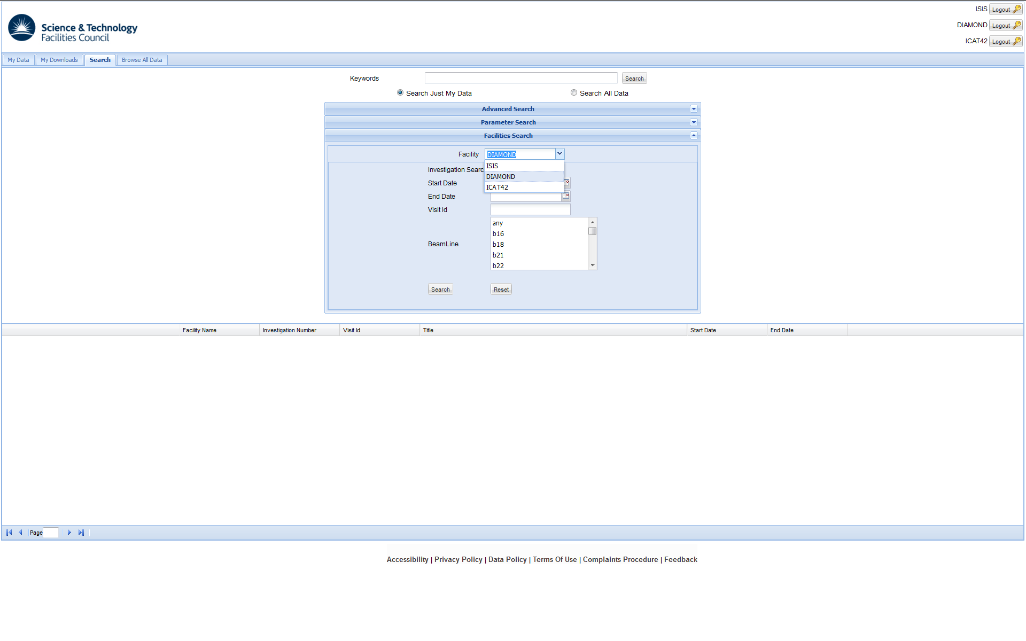
Diamond Facility Search Panel

Slide 24
Writing a Facilities Search Widget
The relevant TopCAT package is uk.ac.stfc.topcat.gwt.client.facility
Update FacilityPluginFactory.class
Write a class that extends FacilityPlugin
For an example see ISISFacilityPlugin.java
Write a search widget
For an example see ISISSearchWidget.java

Slide 25
Summary
deploy.conf and deploy.sh are used to configure and start TopCAT
icat.list, XXX.icat and deploy.sh are used to configure TopCAT to use different ICAT instances
topcat.properties is used to configure the GUI
You can write you own facilities search plugin

Slide 26
?

